Slide 1

Physiotherapy Clinical System By Mennatullah Mahmoud and Menna Abdelsattar
BMd202

Slide 2
Project Management
plan
execute
progress

Slide 3
introduction
Applications are an essential factor in our life as it improves and facilitates all our needs.
Physiotherapy clinical system is a desktop application of physiotherapy clinics.
It is an information system that is developed by C# and NET 5 framework connected to a local SQL database which contains all the data needed by the application.

Slide 4
Aim of the app
The app mainly focuses to ease the system of any Physiotherapy clinic by a unique modern management system.
The doctor will be able to save all patient’s data effectively and safely with few clicks.
The doctor can save all the diagnoses, treatments, and medication of each patient in each session.
The secretary will be able to manage the appointments and track the finance of the clinic easily and effectively.

Slide 5
Benefits of the app
The system is organizational as it provides a larger possibility of documentation
Improvement of operational efficiency
Better interdepartmental communication
Improvement of data accuracy and easy access to data for further research.
All the options needed are provided by the app so that it’s useful for both doctor and patient besides its efficiency that gives a comfortability in use to the users of the clinics.

Slide 6
Technologies used in the app
C# 9
Net 5
SQL database

Slide 7
App details
Login
Dashboard
Calendar
History
Patients

Slide 8
Registration
Login is the landing page of the application
the doctor/secretary will be asked to enter their e-mail and password
Once they are authenticated, they will be able to access the rest of the app.

Slide 9
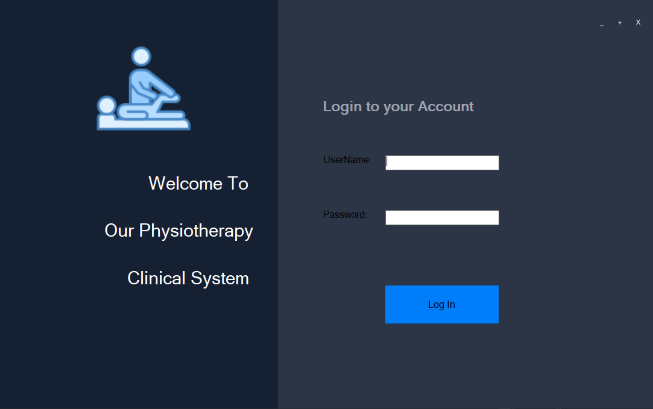

Slide 10
Dashboard
Dashboard allows the admin to do the following:
Add new user
Update existing user
Check finance details
View recent customers
Search for specific user

Slide 11
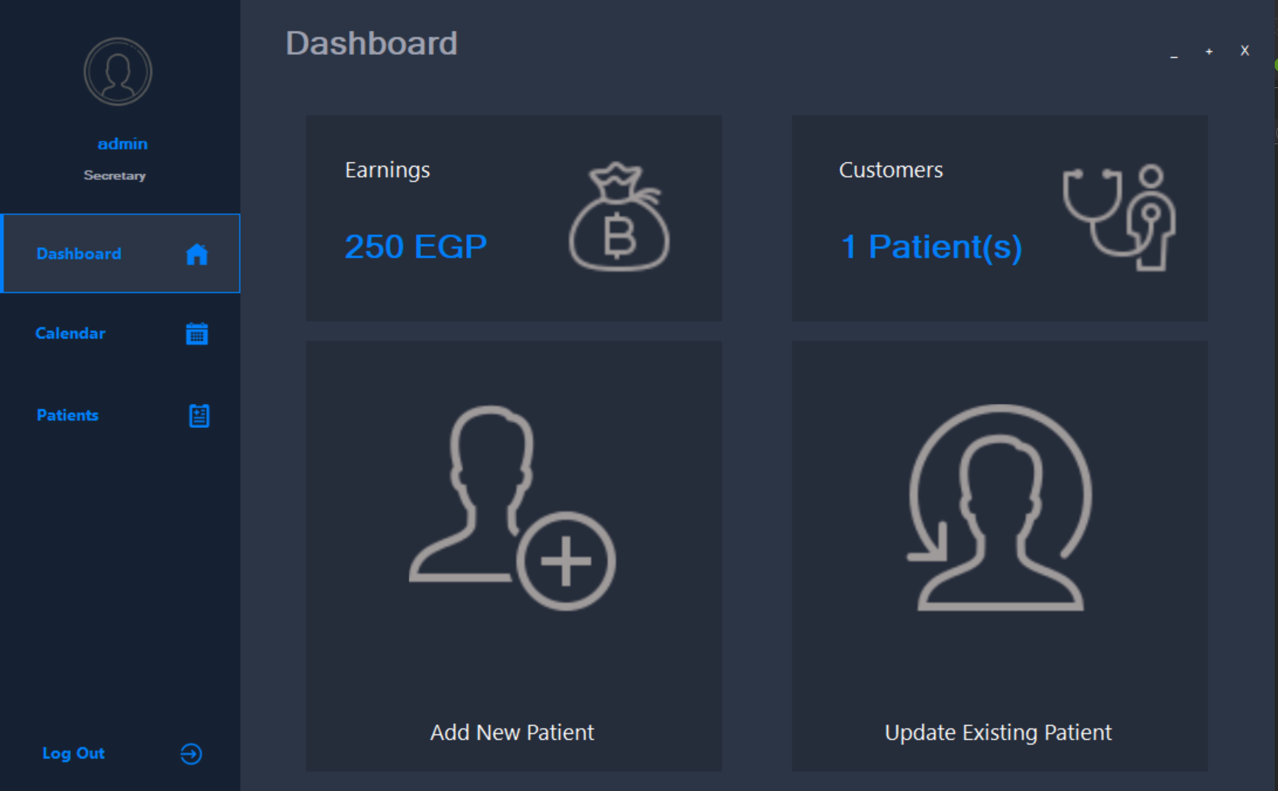
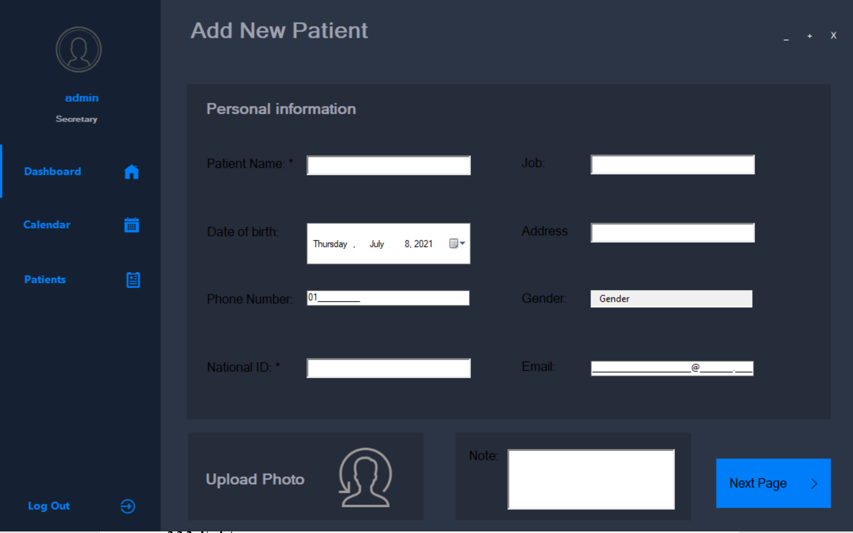
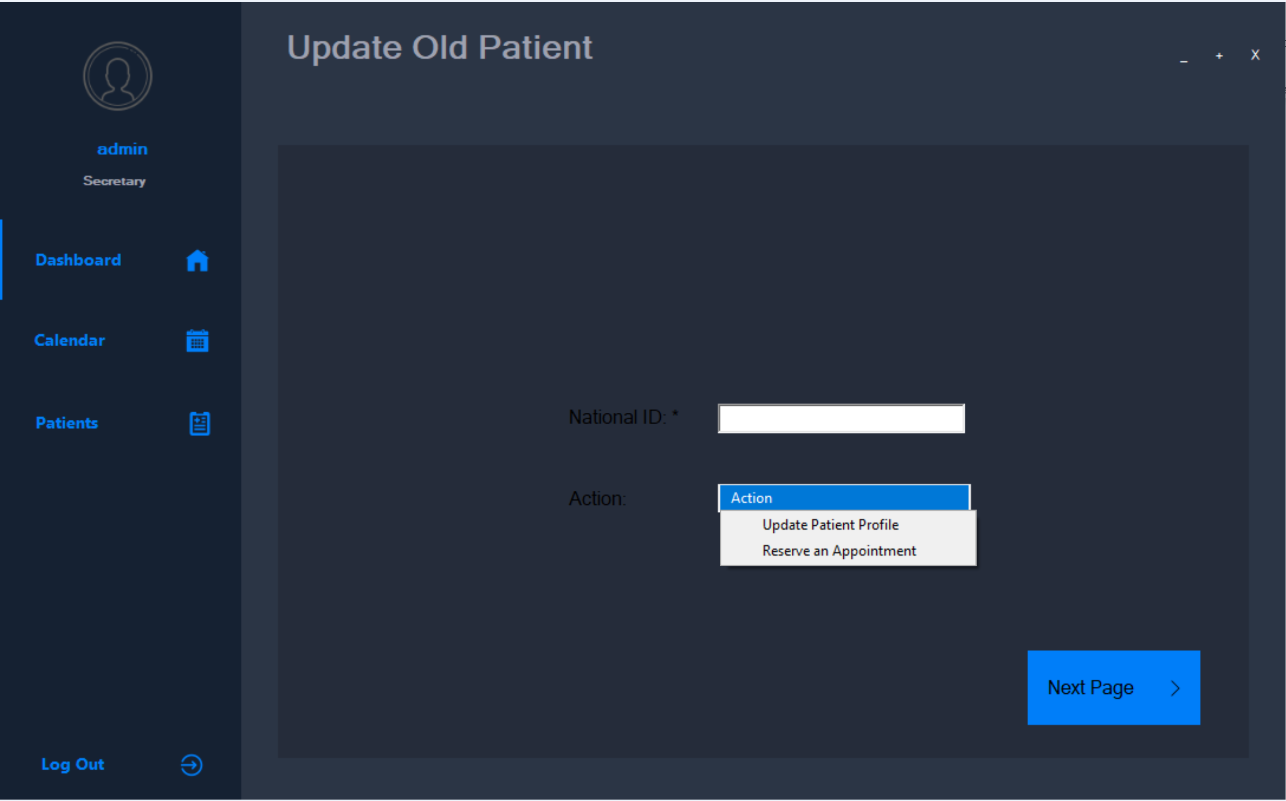

Slide 12
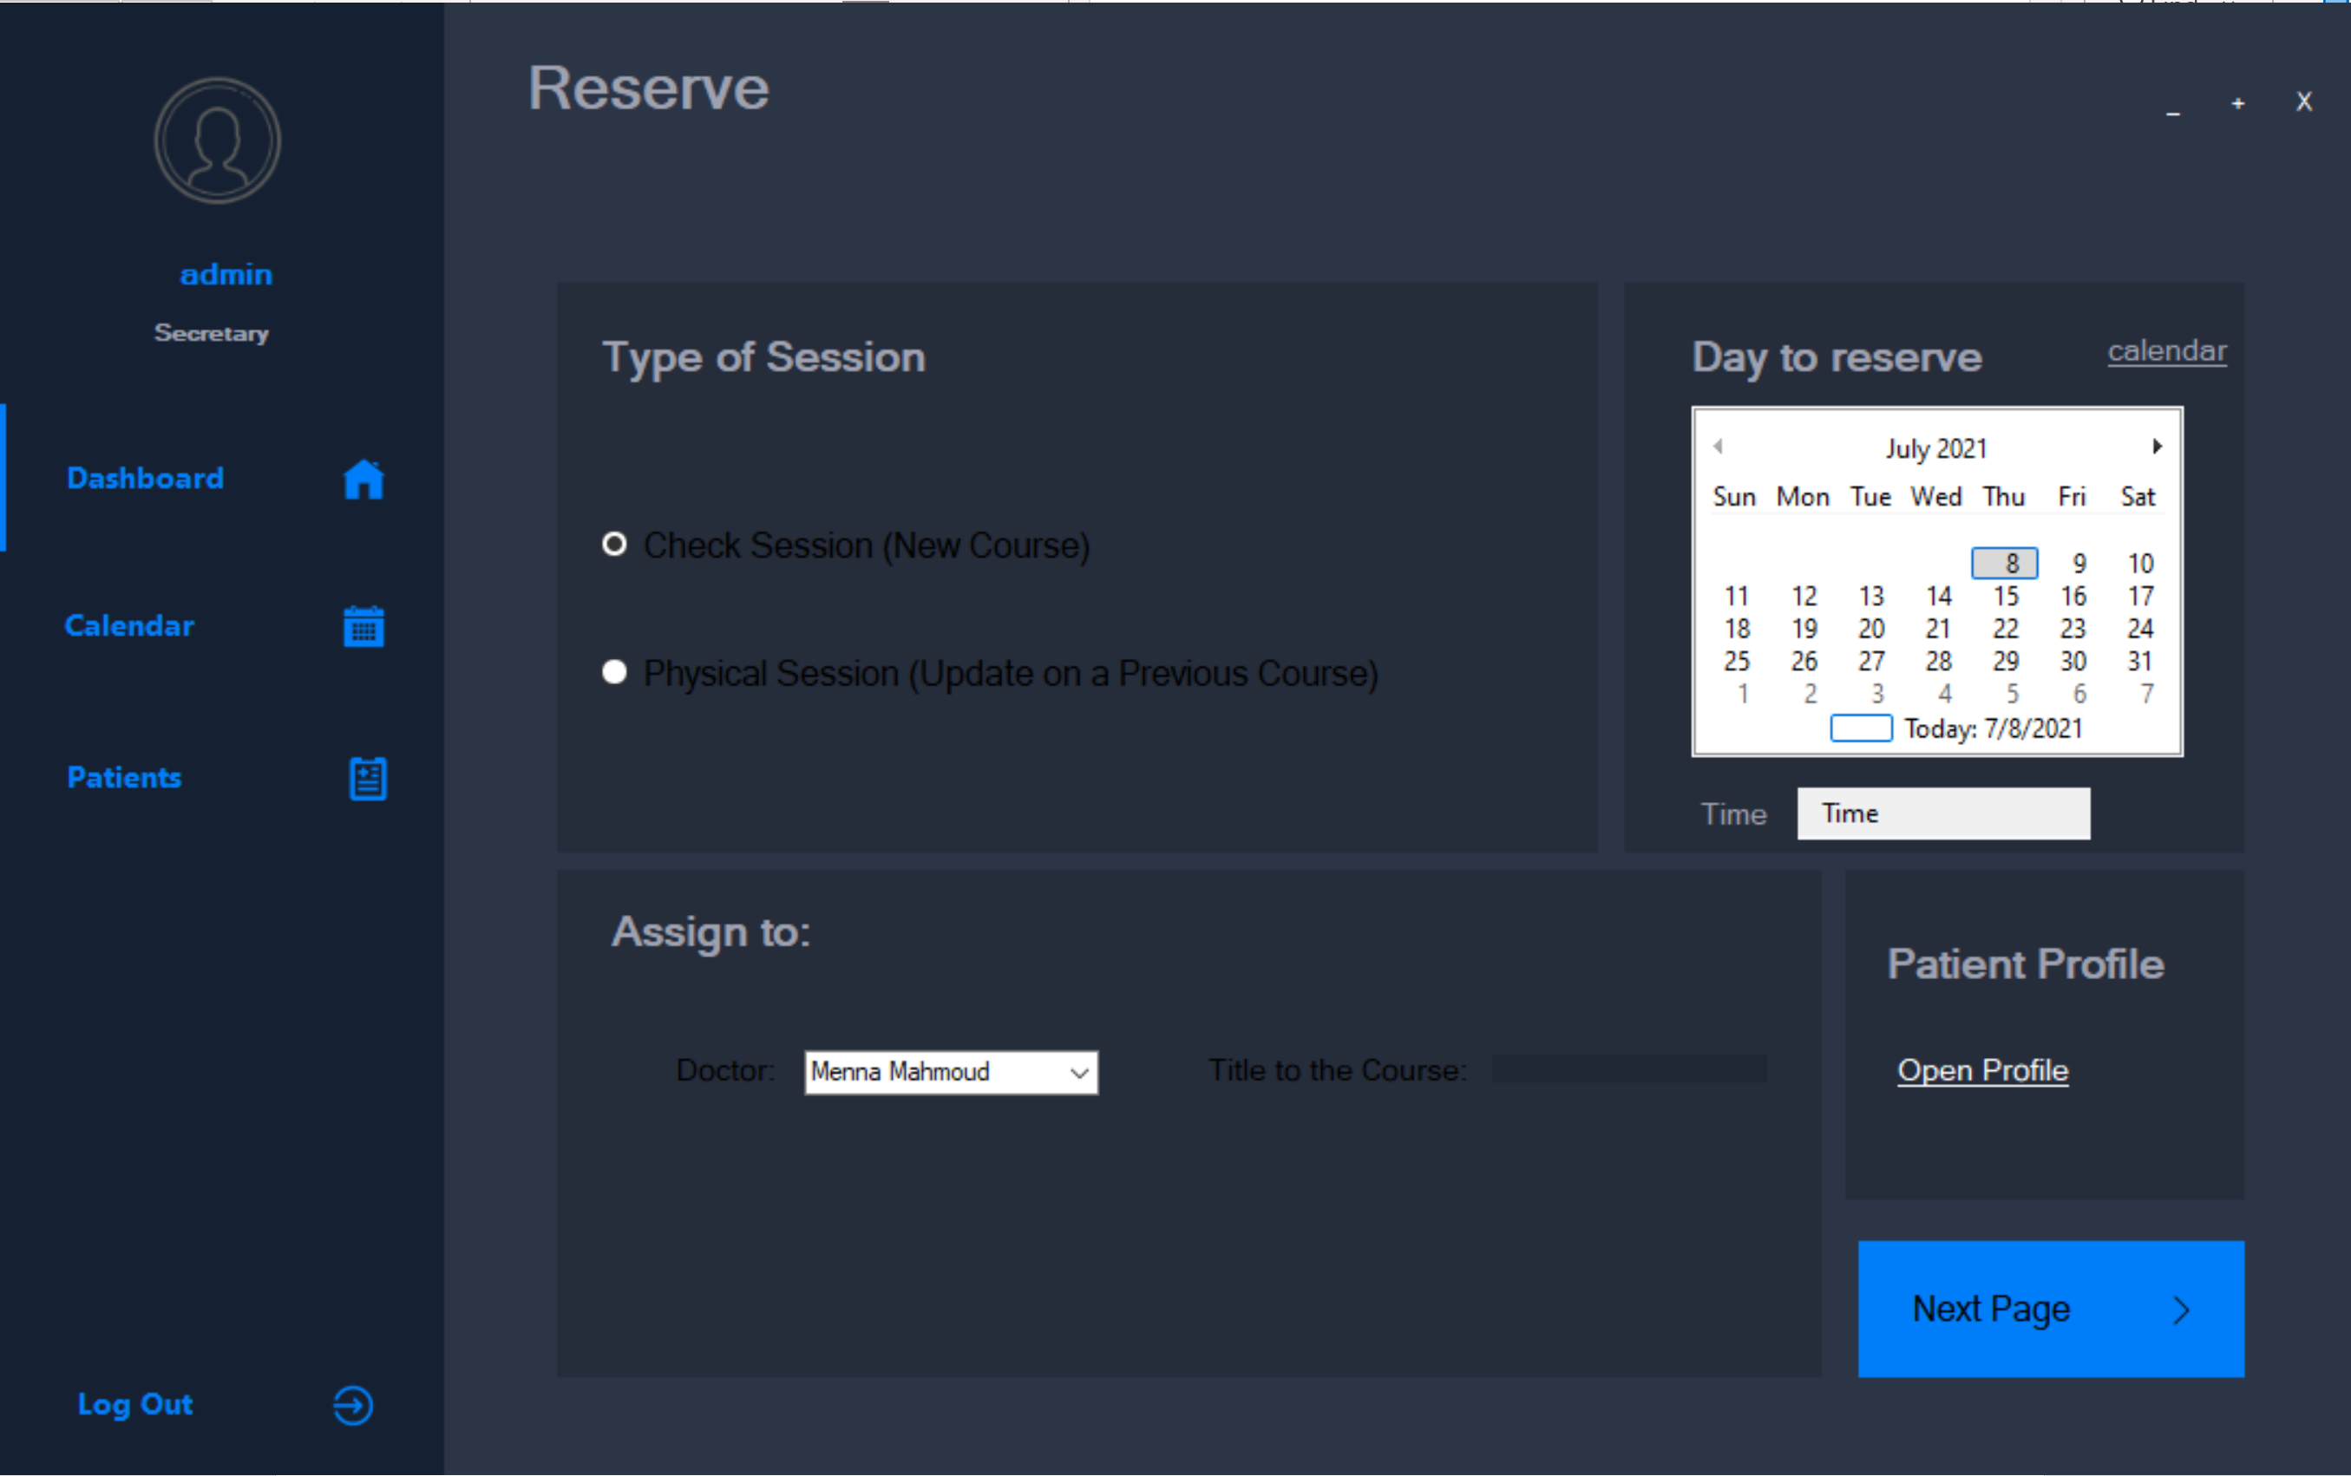
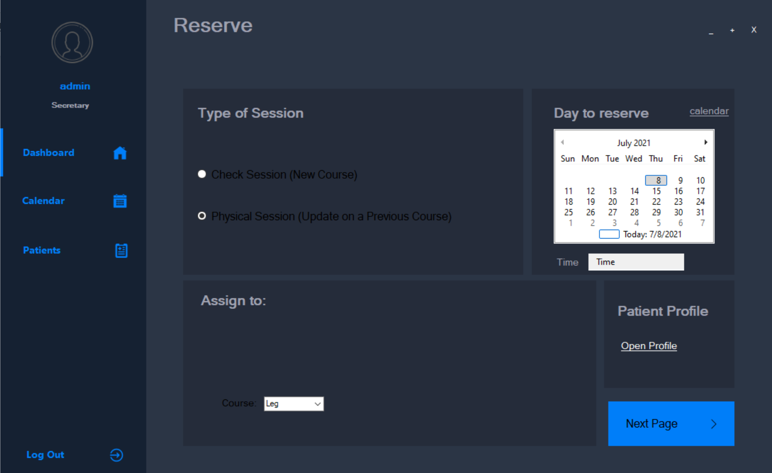

Slide 13
calendar
The calendar allows the admin/secretary to check all the available dates in a calendar
on clicking a specific day a new screen will appear which contains all the appointments on the selected date.

Slide 14
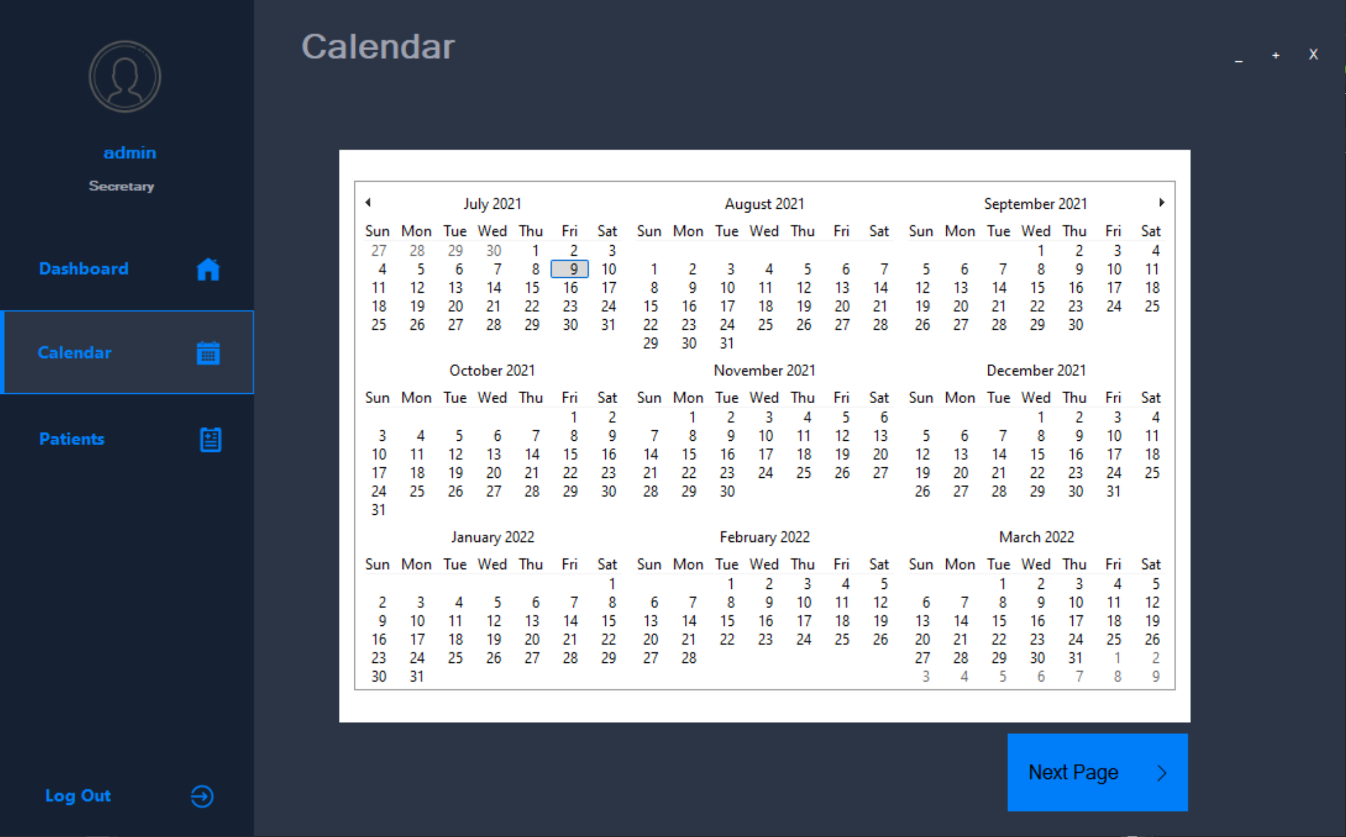

Slide 15
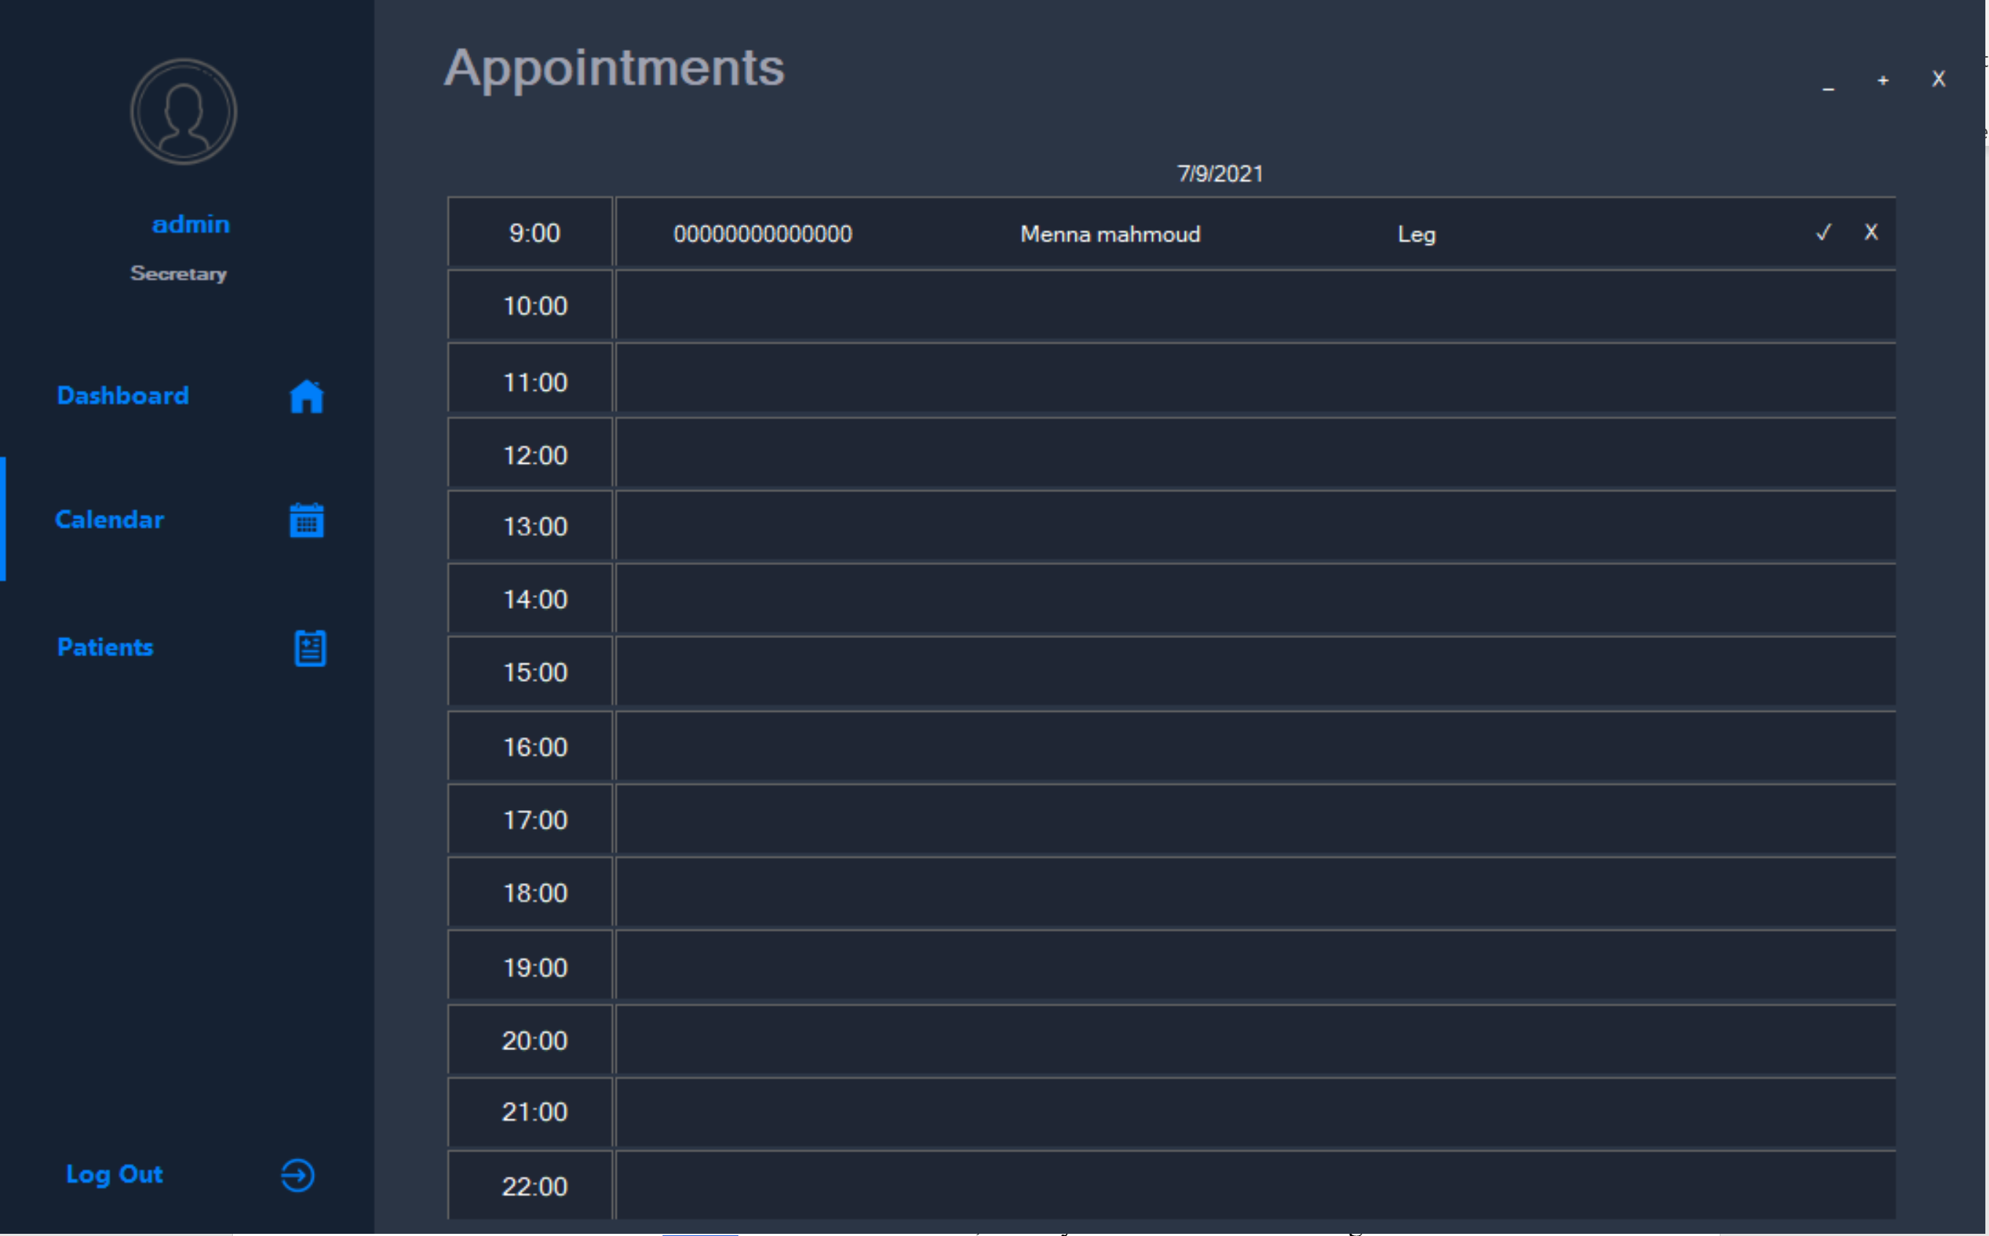
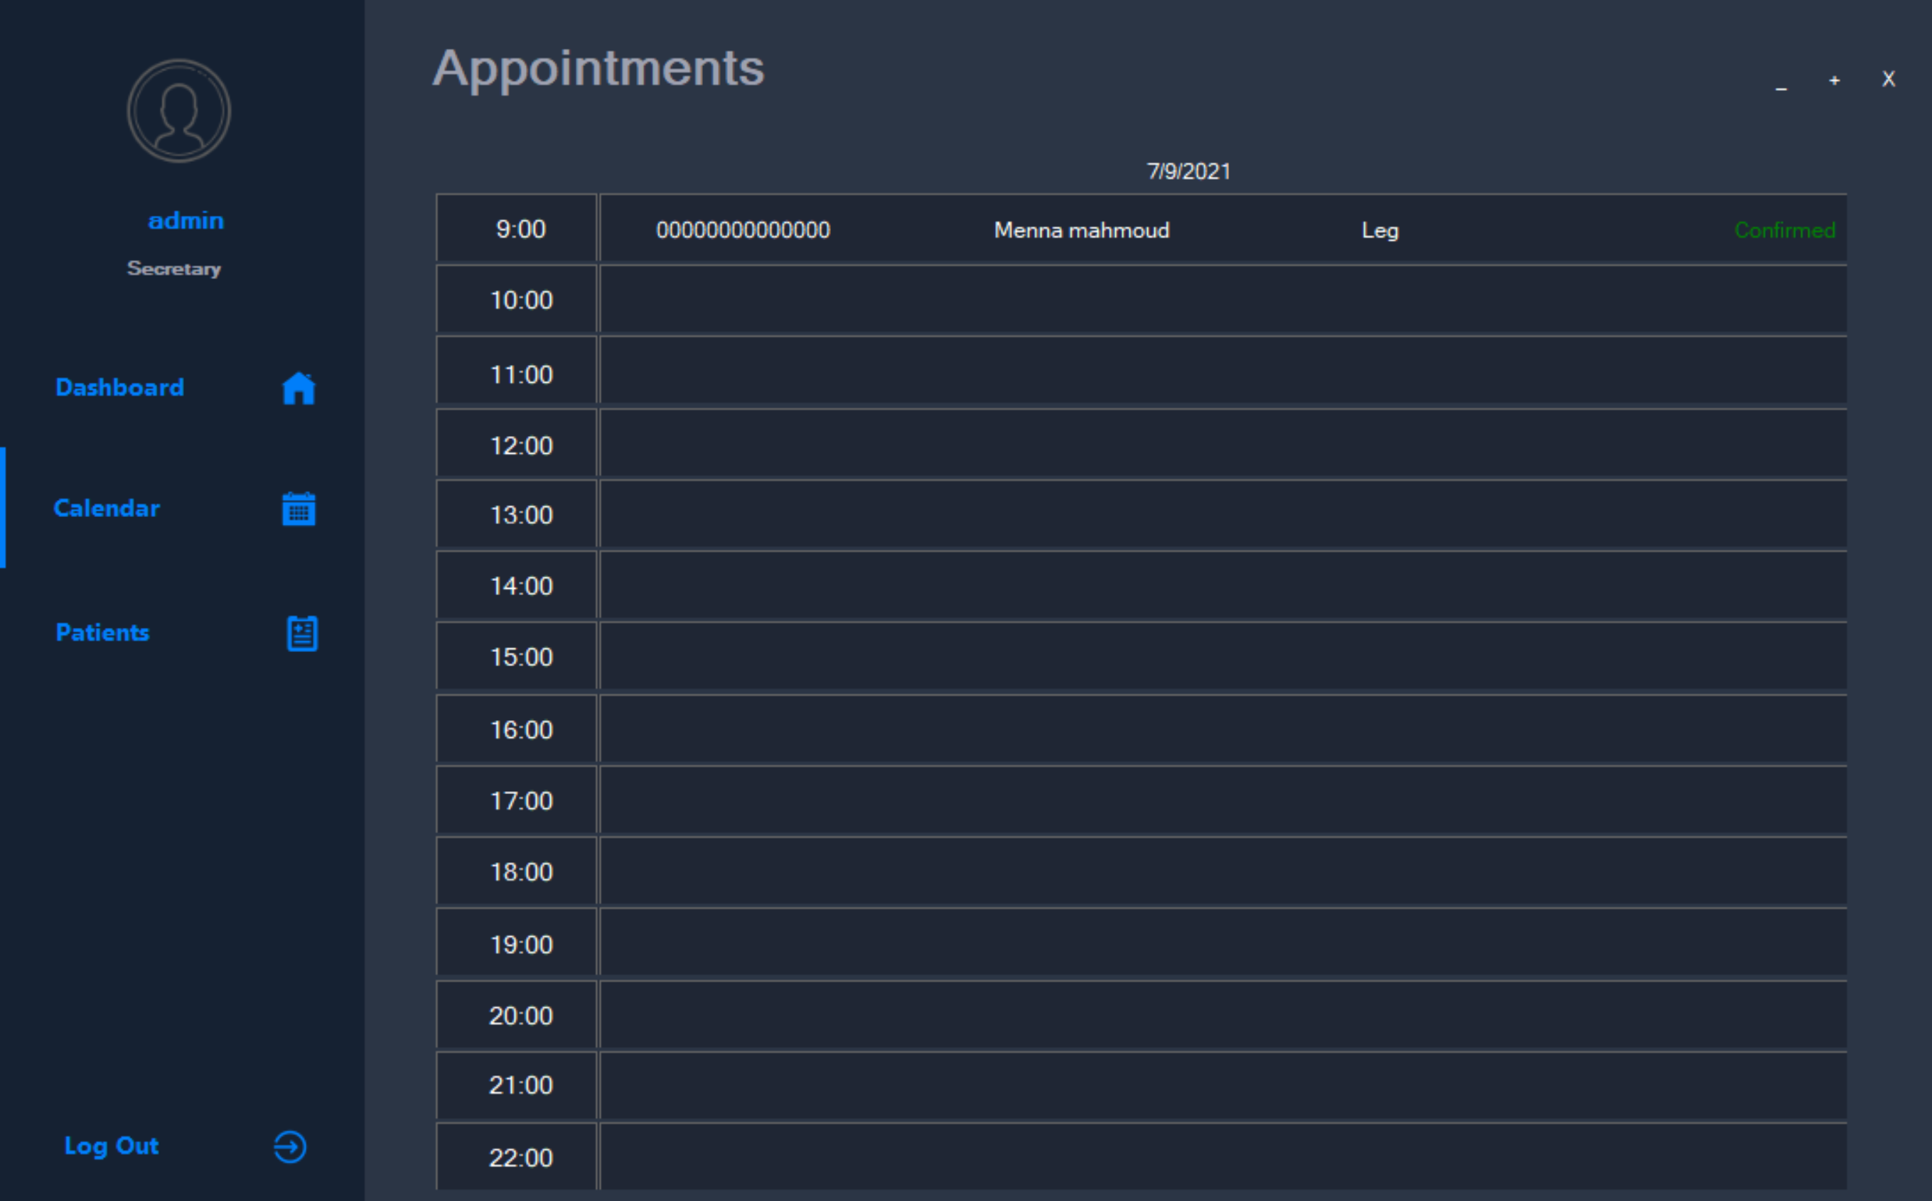

Slide 16
Patients
The doctor/secretary will be able to view all patients
By clicking on any patient a new screen will appear which contains all the profile of the patient.
The profile of the patient contains patient’s personal information and courses he had.
On clicking on courses a new screen will appear which contains all the details about the course.

Slide 17
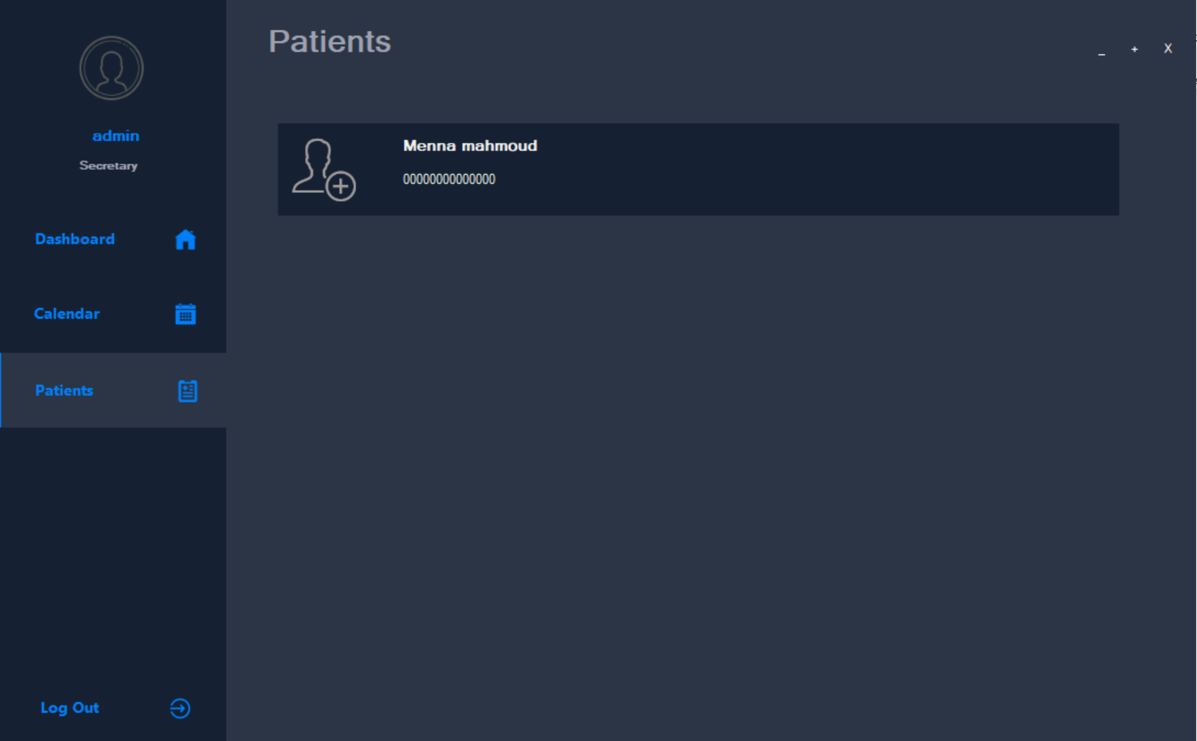
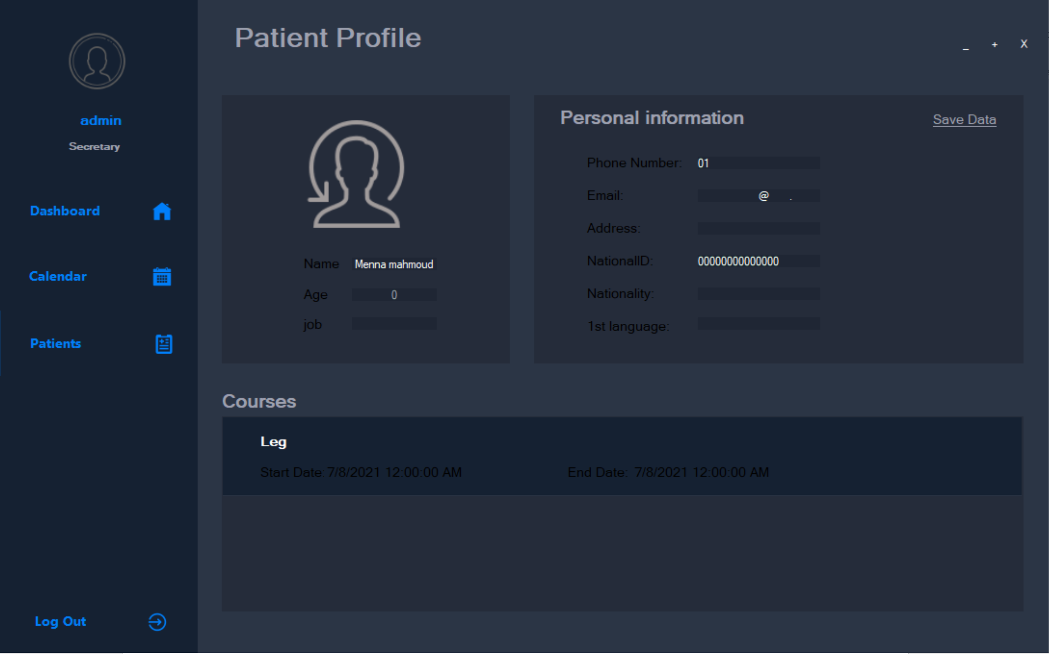
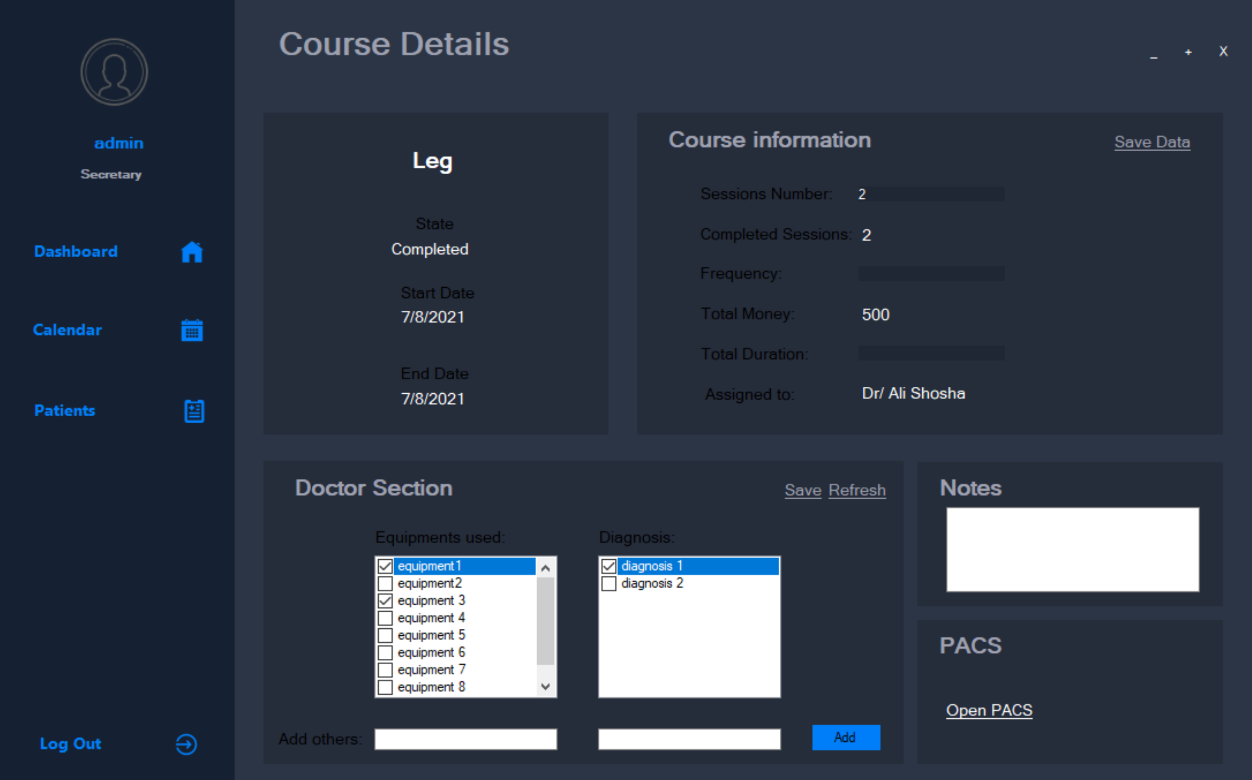

Slide 18
Project planning
Agile software planning including 5 stages
Brainstorming
UI design
UI implementation
Database development
Integration between front end/UI and database

Slide 19
Functional requirements
User login
Fetch patients
Add patients
Update patients
Search patients
Fetch calendar
Add appointment
Add visits
Fetch recent visits
Add history item
Fetch history
Fetch financial details

Slide 20
Non functional requirements
Performance requirements
Safety requirements
Reliability
Accessibility

Slide 21
Progress and backlog
Stage 1 (Brainstorming):
Identify problem ✔
Find different solutions and approaches ✔
Compare between different solutions and approaches ✔
Select best solution ✔
Setting a plan for the development ✔

Slide 22
Progress cont.
Stage 2 (UI design):
Search on existing UIs (dribble website) ✔
Shorting listing relative UIs ✔
Selecting best UI idea ✔
Making a blueprint ✔
Making a mockup ✔

Slide 23
Progress cont.
Stage 3 (UI implementation):
Searching about desktop UI in .NET 5 ✔
Selecting the suitable components for the UI ✔
Designing the “View Models” for the application ✔
Setting the UML class diagram ✔
Write down the flow of the app ✔
Start Coding ✔

Slide 24
Progress cont.
Stage 4 (Database Development):
Designing the database ✔
Implementation of database ✔

Slide 25
Progress cont.
Stage 5 (Integration):
Make a Connection to the database ✔
Make stored procedure functions in the database✔
Integrate the functions to the system✔

